Slide 1
Bike Sharing Company Visualizations
File created on: 7/11/2025 8:12:22 AM
Created by: Lance Montero

Slide 2
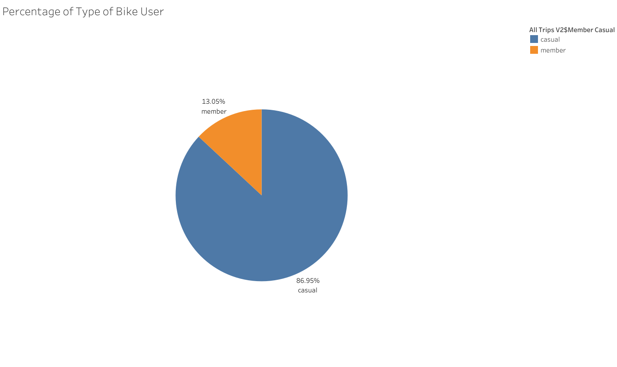

Slide 3
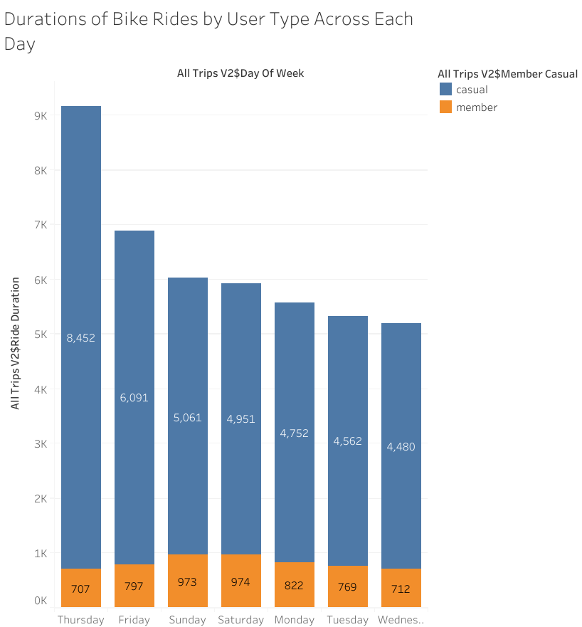

Slide 4
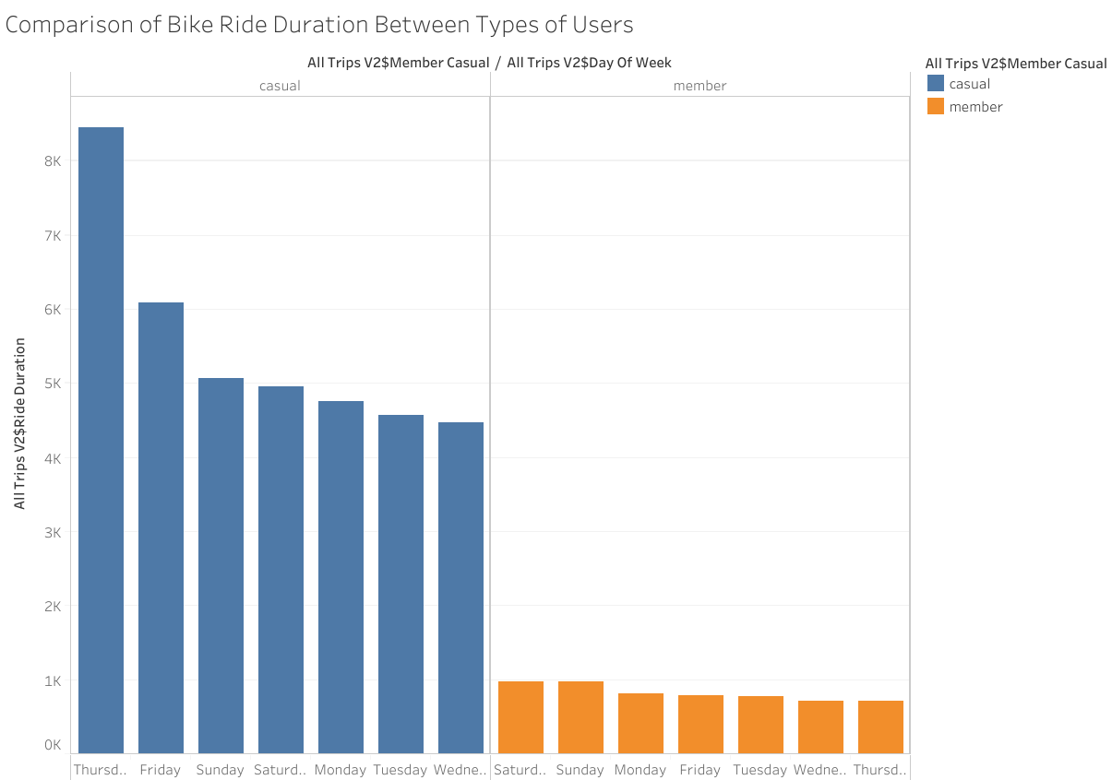

Slide 5
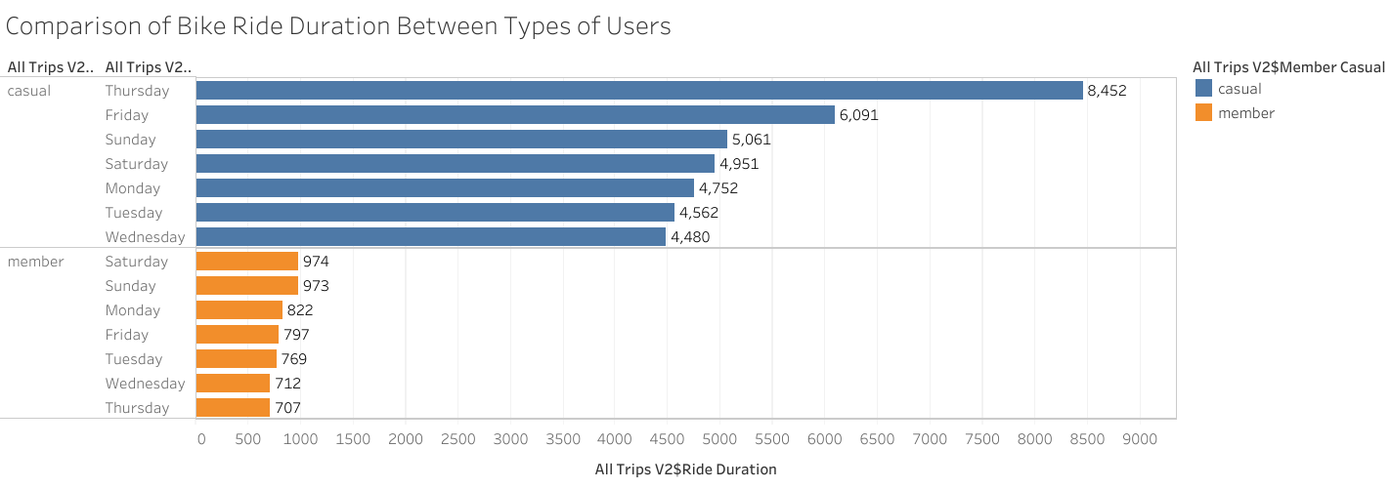

Slide 6
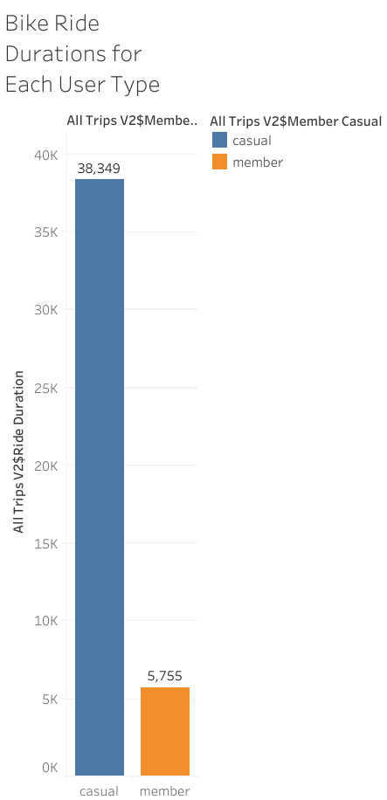

Slide 7
